Slide 1
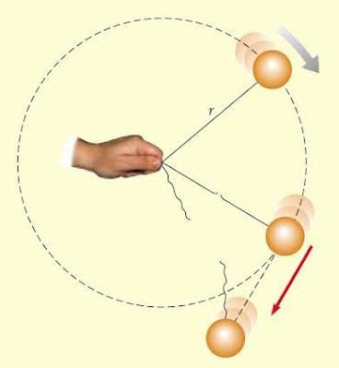
Rotations and Revolutions – Page 1
Ever played on a merry-go-round? Just like a toy spinning around in a circle, our Earth does the same. This is called rotation. It’s much slower than your toy, though. Because of Earth's rotation, we experience day and night. When your side of Earth faces the sun, it's daytime. You can see everything around you clearly. But when your part of the world turns away from the sun, it becomes night. Everything gets dark and the stars come out to play. That's why we have bedtime! So, the next time you're on a merry-go-round, just remember, you're just like the Earth!
What is Earth’s spinning called? ___________________________________________________________________
What do we experience because of Earth’s rotation? ___________________________________________________________________
What happens when your part of Earth faces the sun? ___________________________________________________________________
Have you ever spun a ball on a string? The ball zooms around in a circle. This is quite similar to what the Earth does. Imagine the ball as the Earth, and your hand as the sun. The string between your hand and the ball represents an imaginary line or path that the Earth takes around the sun. This path is called an orbit. Earth's journey along this orbit around the sun takes one whole year. We call this journey a revolution. That's why we celebrate a new year every 365 days. Isn't that something to think about?
What is the path that the Earth takes around the sun called? ___________________________________________________________________
How long does it take for the Earth to complete its orbit around the sun? ___________________________________________________________________
What is the journey around the sun called? ___________________________________________________________________

Slide 2
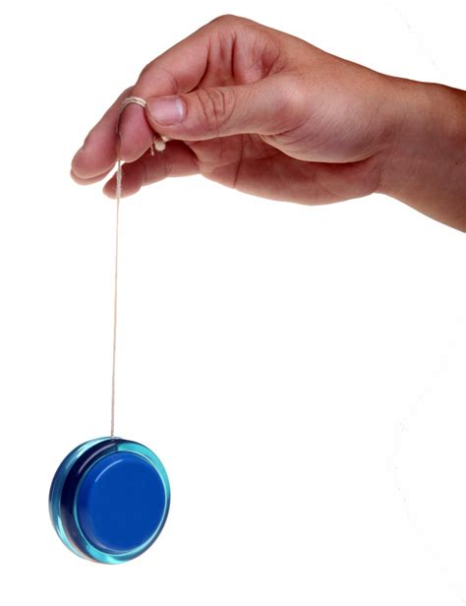
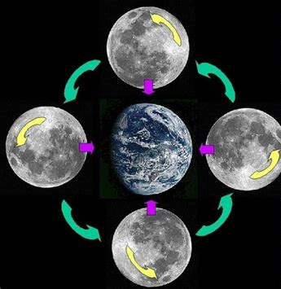
Rotations and Revolutions – Page 2
Yo-yos are fun, right? Going up and down, up and down. Now, picture the yo-yo as the moon and your hand as the Earth. The string that connects your hand and the yo-yo is the moon's orbit. Unlike the yo-yo, the moon doesn’t go up and down, but it moves around the Earth in a circle. This is the moon's revolution. It takes about a month for the moon to complete its journey around Earth. That's why every month, we see a full moon. Remember this the next time you play with a yo-yo!
What does the yo-yo represent in our example? __________________________________________________________________
What does your hand represent in our example? __________________________________________________________________
What is the moon’s journey around the Earth called? __________________________________________________________________
Just like the Earth, did you know that the moon spins too? Yes, like a top, the moon rotates. But it's much slower. In fact, it spins so slowly that it takes about the same time to rotate once as it does to complete its orbit around Earth. Because of this, from our viewpoint on Earth, it seems like the moon is not spinning at all! That's why we always see the same face of the moon. So the next time you look up at the moon, remember, it's always the same side you're seeing!
Does the moon spin like the Earth? __________________________________________________________________
How fast does the moon spin compared to its orbit around Earth? __________________________________________________________________
How long does it take for the moon to rotate once? __________________________________________________________________

